Slide 1



UNH SEDS
CEPS Engineering Organization
High Power Rocketry
University of New Hampshire
Students for the Exploration and Development of Space

Slide 2
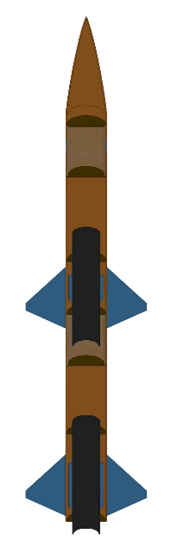


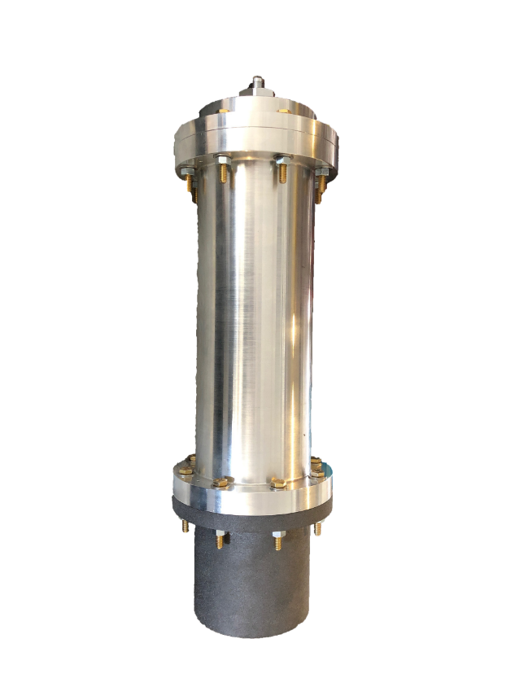
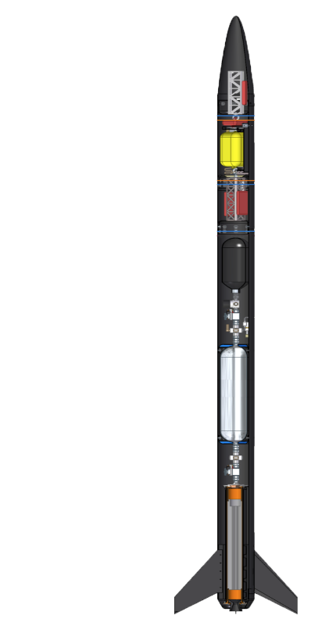

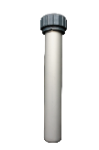

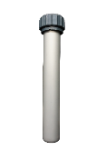
The Three Year Plan
Year One
2017-2018
Hybrid Engine
Design
Manufacture
Test
Year Three
Runaway
Rocket Building
Simulating
Launching
Optimizing
Hybrid Rocket
Engine Optimization
Rocket Integration
Competition
Year Two
University of New Hampshire
Students for the Exploration and Development of Space

Slide 3
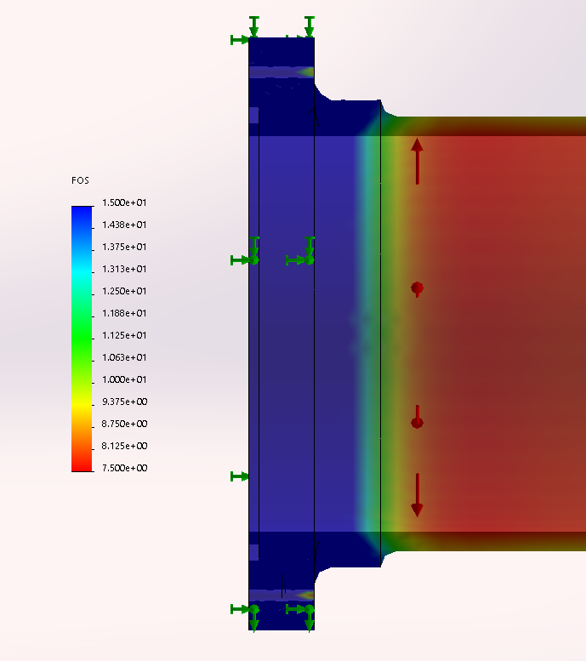
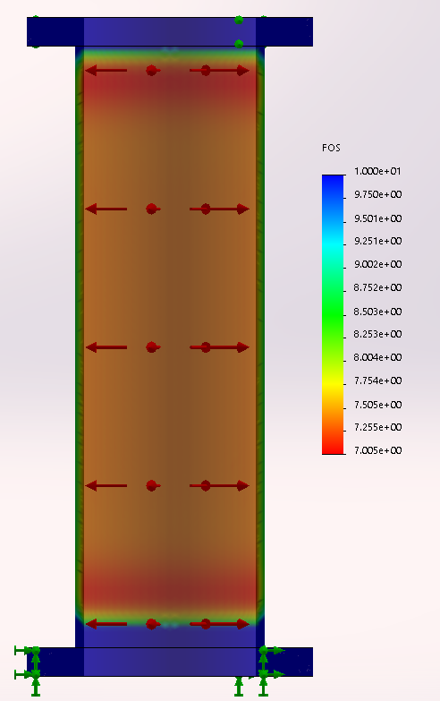
Propulsion Team
University of New Hampshire
Students for the Exploration and Development of Space

Slide 4
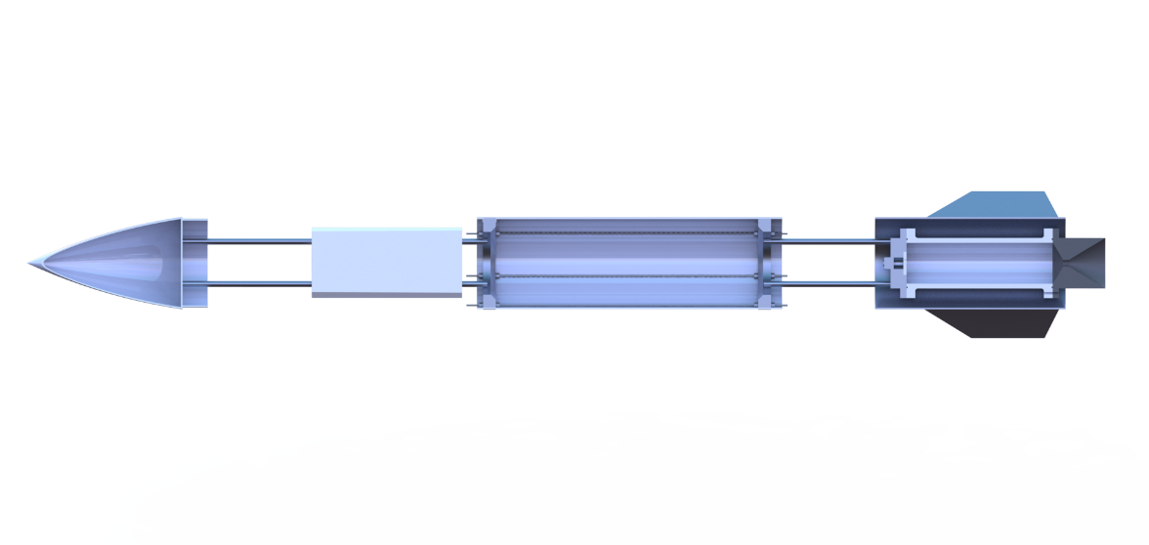
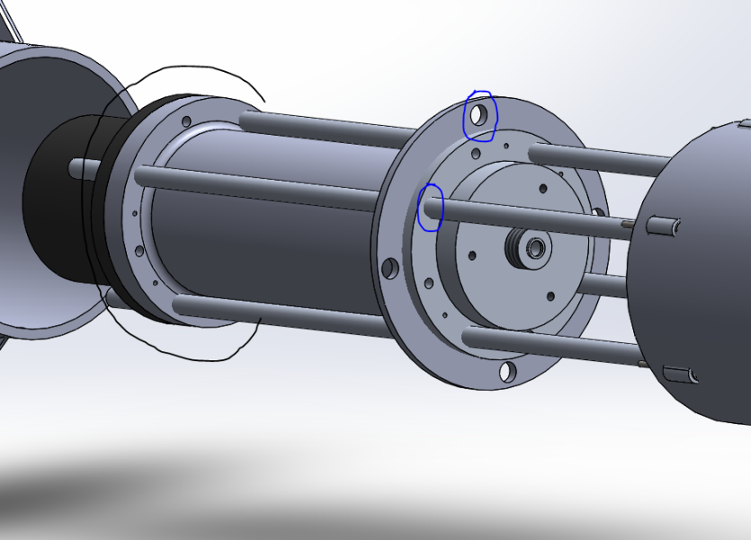
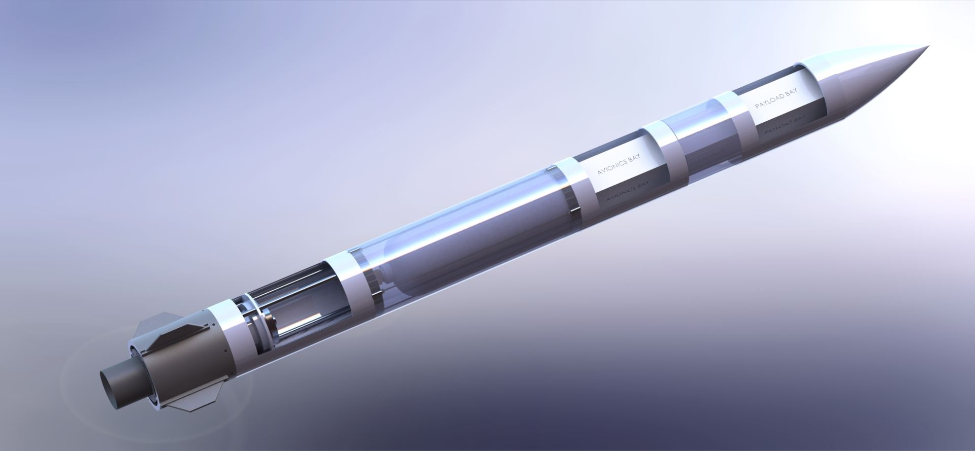
Frame Team
University of New Hampshire
Students for the Exploration and Development of Space

Slide 5
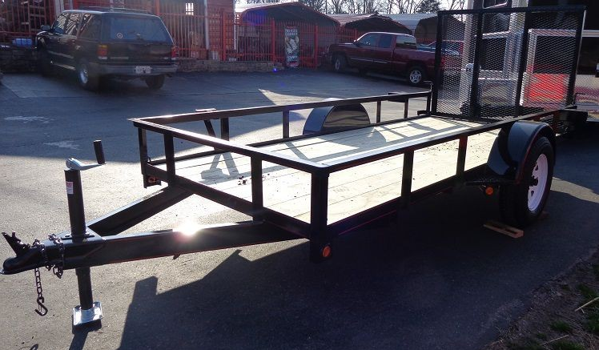

Operations Team
In charge of all Spaceport coordination and requirements
Engineering integration and systems engineering
Responsible for coordinating tests
Safety
Aid in all engineering-related activities
University of New Hampshire
Students for the Exploration and Development of Space

Slide 6

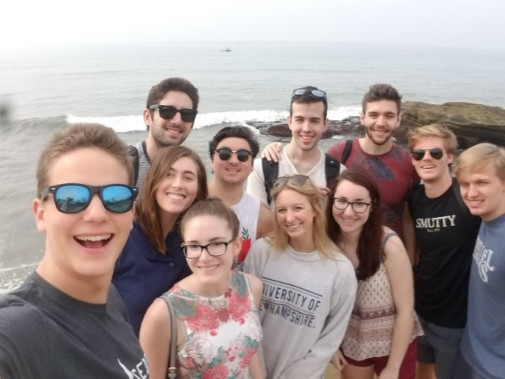
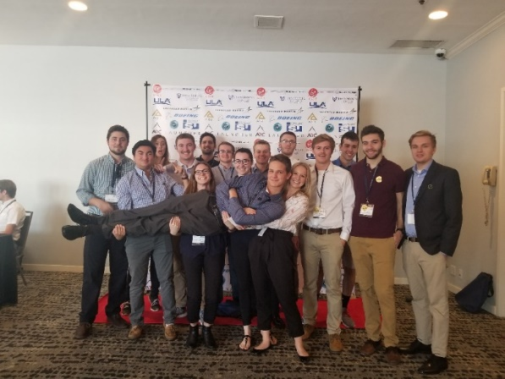

How Can You Help?
Looking for students who’d be willing to help with CAD modeling of rocket components in frame, propulsion, and other needs that come up.
Students interested in learning SolidWorks CAD, FEA, and FlowSimulation
Integrate into one of our teams, given a modeling project to complete and aid our senior project.
Good experience to integrate into a team as a freshman.
If interested, contact me at sgj1001@wildcats.unh.edu (Silas Johnson – Mechanical Engineering Project Manager)
@unhseds
University of New Hampshire
Students for the Exploration and Development of Space
Notes:
EE major too

